Slide 1



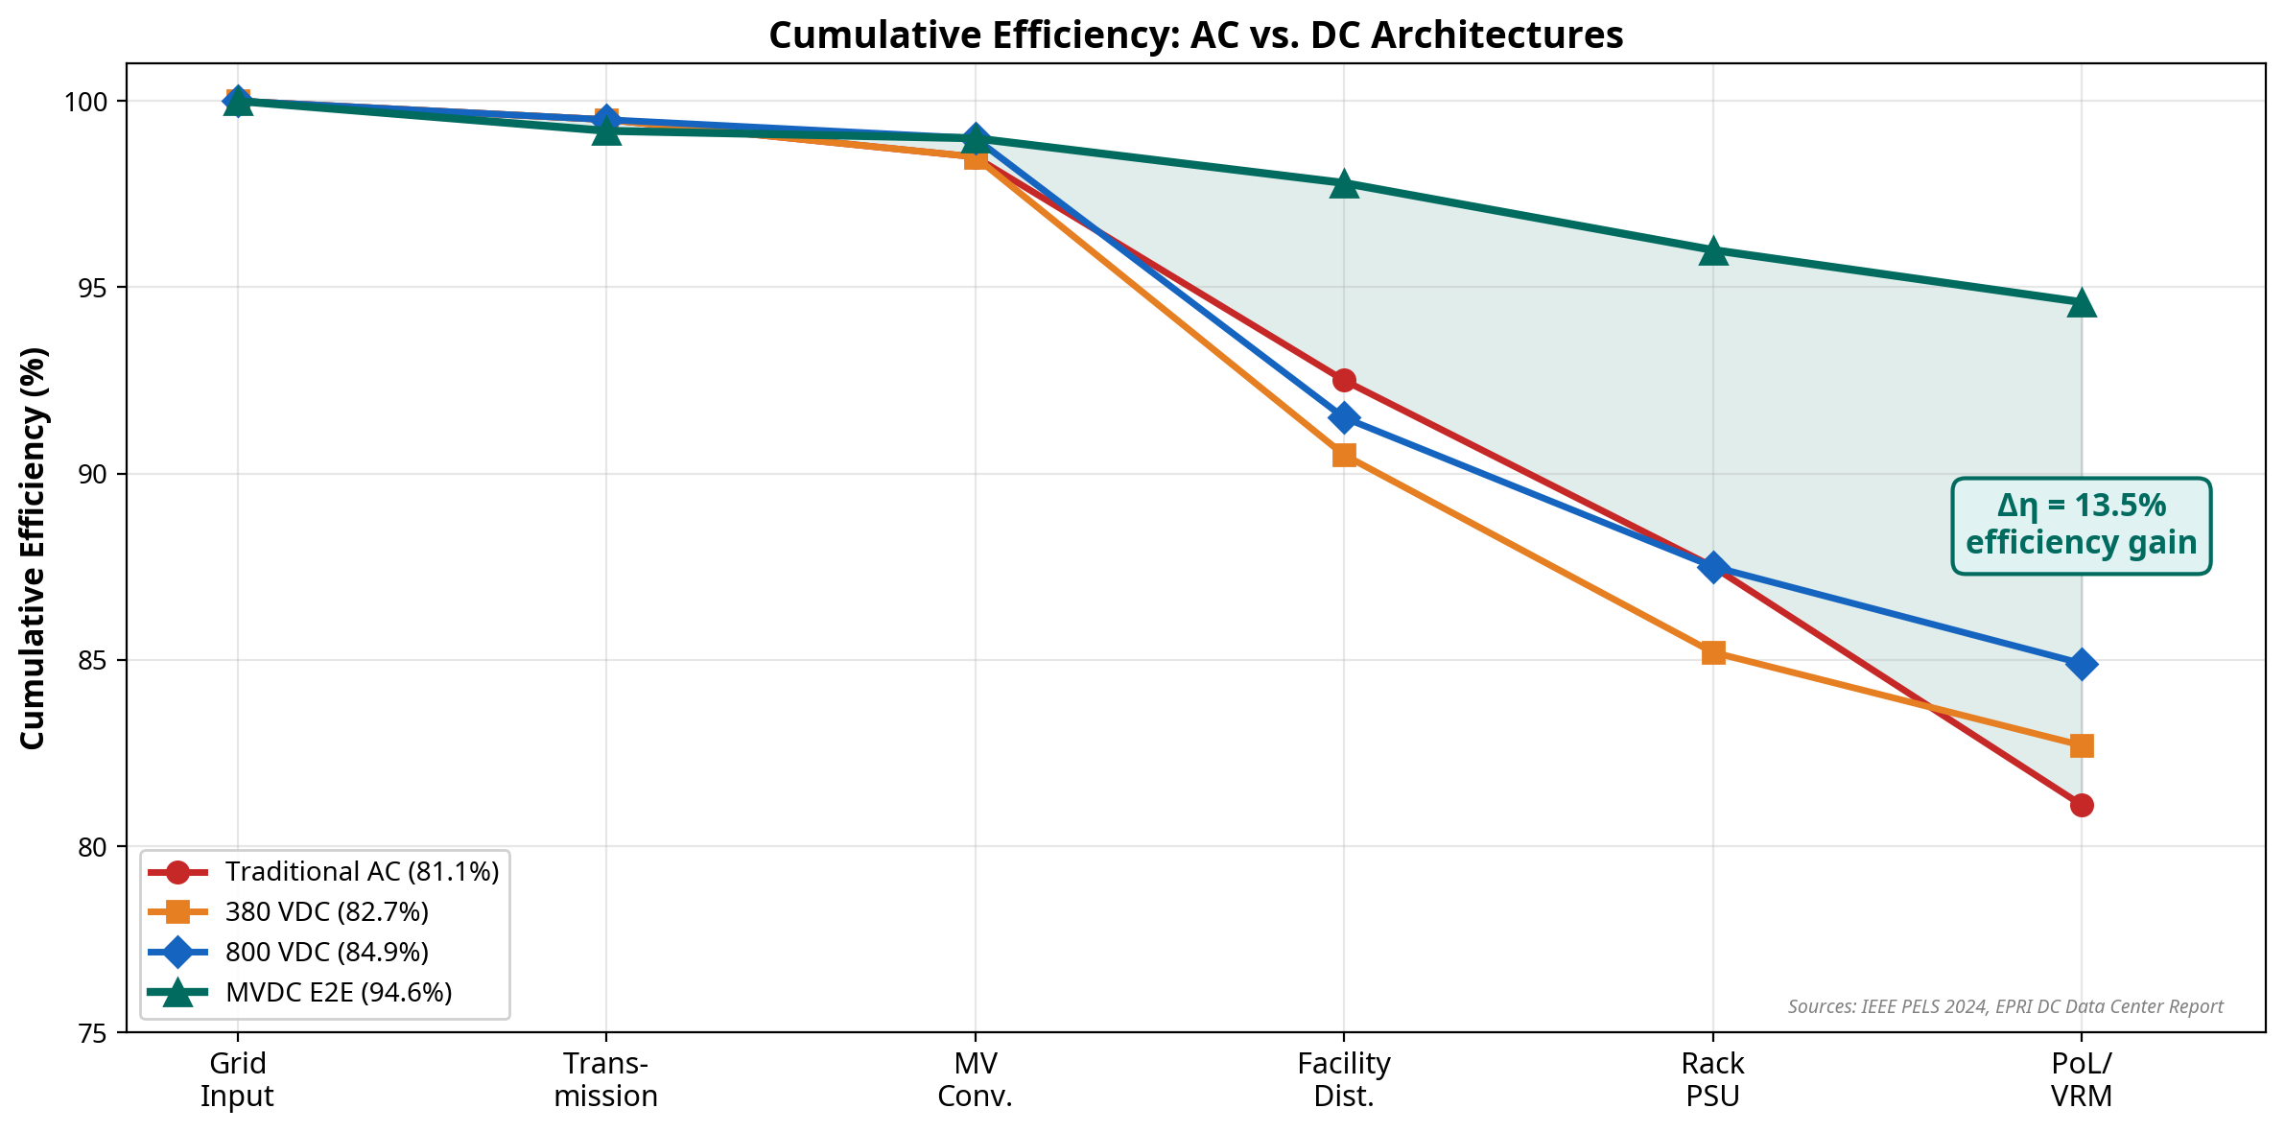
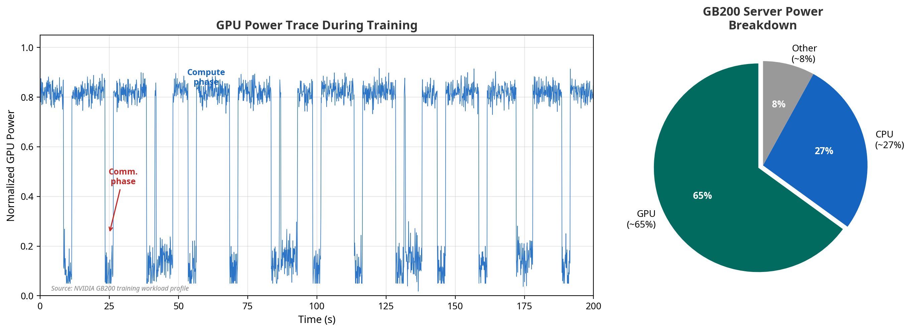
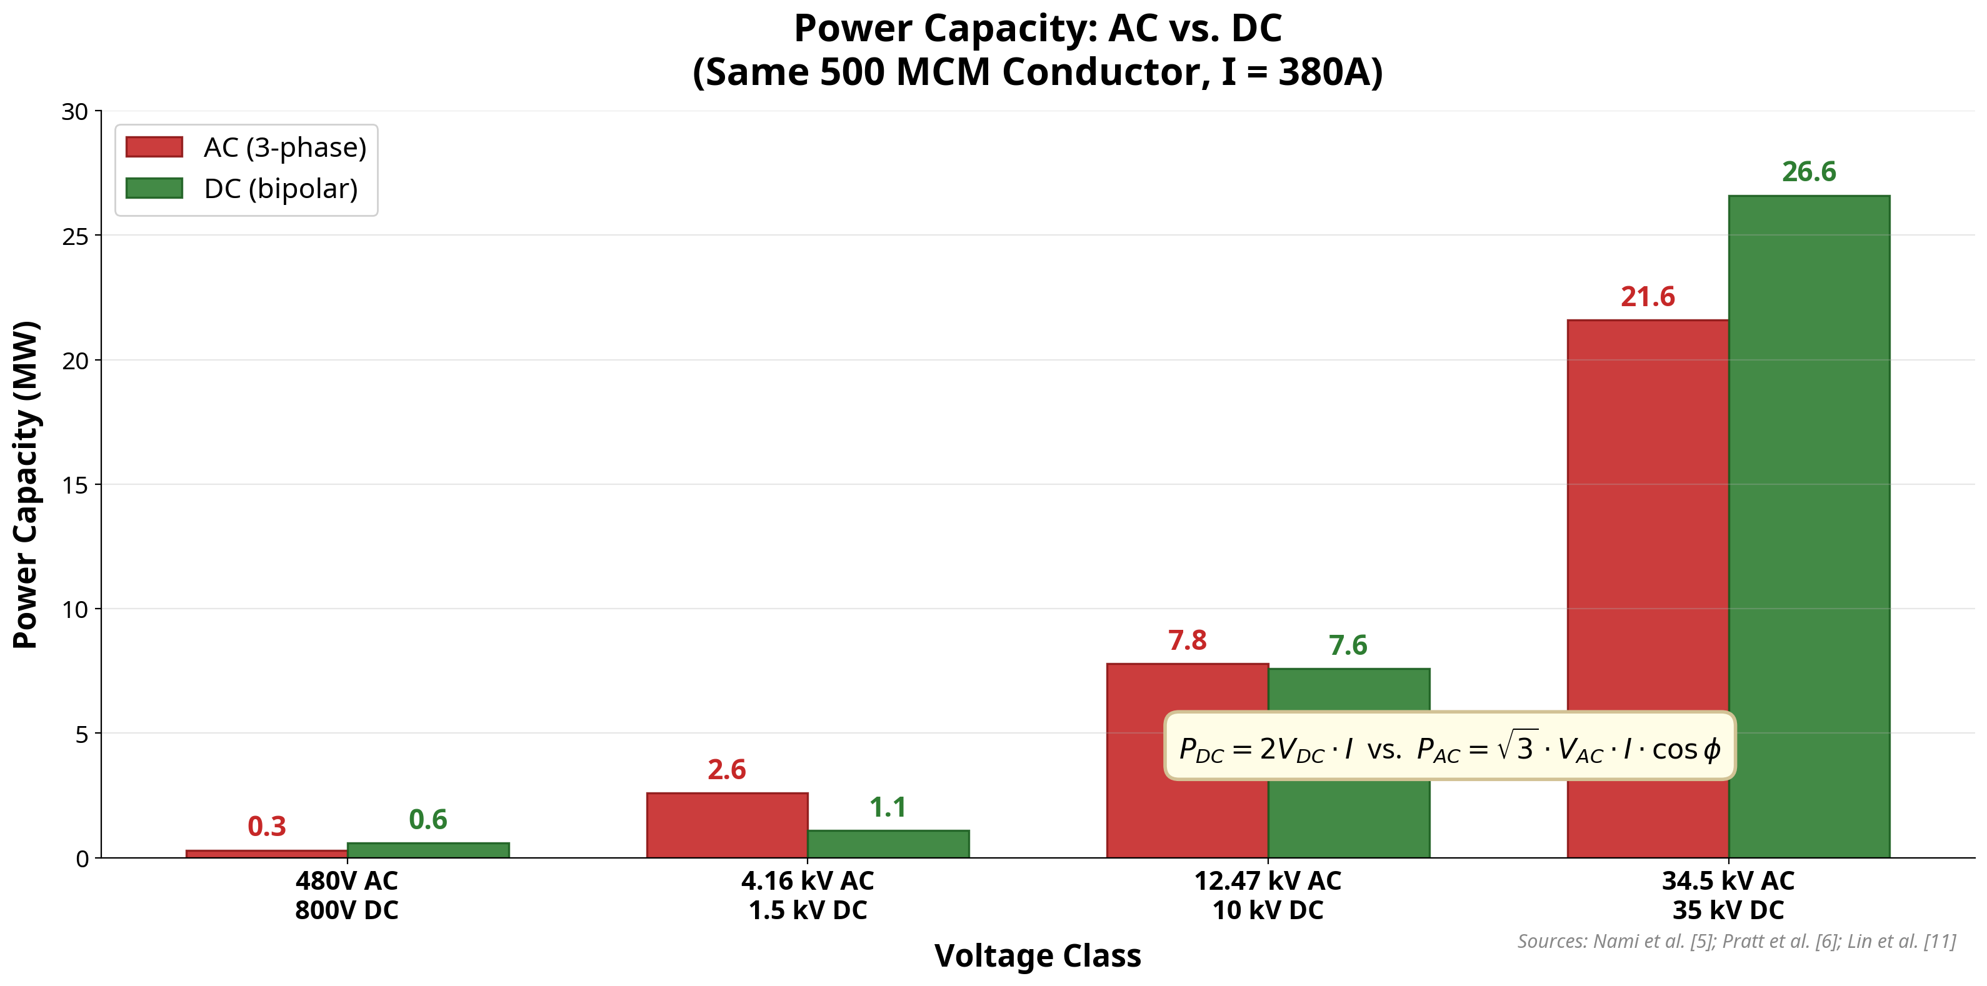
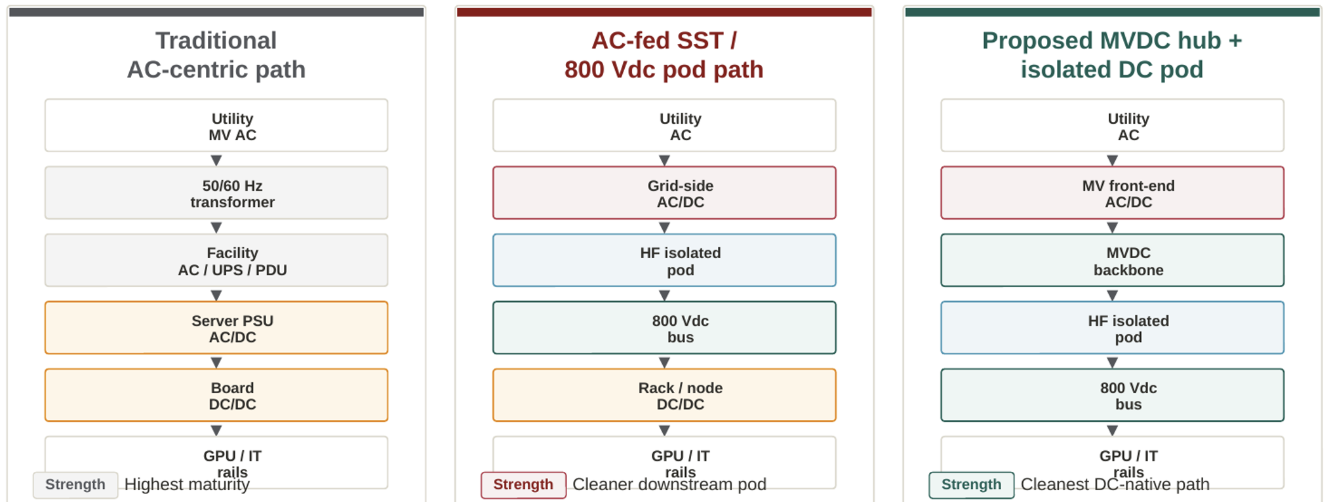
Direct Current (DC) Subtransmission Backbone for AI Factories
Jane Yang (yjane@stanford.edu) Liang Min (liangmin@stanford.edu)
MOTIVATION
BENEFIT 1: CUMULATIVE EFFICIENCY
ARCHITECTURE COMPARISON
Why Revisit the Power Path Now?
AI-training loads are changing the problem from a purely steady-state efficiency problem into an architecture + power-dynamics problem.
The GPU is the dominant power consumer (~65%), and synchronized GPU activity creates periodic power swings visible at the datacenter level.
The MVDC architecture eliminates redundant conversions.
η_total = ∏(η_i): AC (N=5–6) ≈ 81% vs. DC (N=3–4) ≈ 94.6%
For a 100 MW AI factory: ~13.5 MW saved ≈ $11.8M/year.
Axis | Traditional AC | AC-fed SST 800 Vdc | MVDC Hub (Proposed)
Facility Interface | AC-native utility + facility protection | AC input still at pod / cluster front end | Centralized MV AC/DC feeding MVDC bus
Pod Complexity | Repeated downstream AC/DC + DC/DC stages | High: PFC + HF link + 800 Vdc output | Simpler: HF link only, AC/DC moves upstream
DC-Native Integration | Extra interfaces for storage / solar / DC | Better local DC, but AC still upstream | Best fit: BESS, solar, rack DC all native
Harmonic / PF Ownership | Distributed across AC facility + servers | Handled locally at each pod interface | Centralized at common MV front end
Maturity | Highest | Prototype to emerging products | Proposed in this work
Main Bottleneck | Repeated conversions, copper, facility sprawl | SiC cost, HFT insulation, capacitor stress | MVDC protection, fault handling
The MVDC-hub proposal is strongest as a system-architecture story
Sources: IEEE PELS 2024; EPRI DC Data Center Report; Rasmussen WP#63
PROPOSED ARCHITECTURE
BENEFIT 2: HARMONICS & POWER QUALITY
Three Scenarios:
1. Traditional AC-centric
Utility MV AC → MV/LV Transformer → UPS (AC→DC→AC) → PDU → Rack PSU (AC→DC) → VRM (DC→DC) → GPU. Six conversion stages. Highest maturity but lowest efficiency.
2. AC-fed SST / 800 Vdc Pod (NVIDIA et al.)
Utility MV AC → Solid-State Transformer (AC-DC) → HF Isolated Link → 800 Vdc Bus.
Four conversion stages. Reduces downstream complexity, but AC still enters at the pod front-end each pod must independently handle harmonics and power factor correction.
3. Proposed: MVDC Hub + Isolated DC Pod
Utility MV AC → Centralized MV AC/DC Front-End (PFC + Harmonics) → MVDC Backbone (DC Subtransmission) → HF Isolated DC Pod → 800 Vdc Bus
Three to four conversion stages. Harmonics and PF are handled once at the centralized front-end. The DC backbone natively supports BESS, solar PV, and rack-level buffering.
Target: Utility AC → MV AC/DC → MVDC Hub → Isolated DC Pod → GPU
In AC architectures, every server PSU injects harmonics and requires PFC. Management is distributed across 4–5 points.
With MVDC, harmonic and PF handling become centralized once at the MV AC/DC front-end, instead of
For utilities: AC-side power quality managed only once at the grid interface — simplifying IEEE 519 compliance.
BENEFIT 3: VOLTAGE MGMT & DC-NATIVE PATH
CONCLUSION & FUTURE WORK
Conclusion
The MVDC subtransmission backbone offers a compelling path for next-generation AI factories: fewer conversion stages, centralized power quality management, simpler voltage regulation, and native DC integration for storage and renewables.
Future Work:
• MVDC protection schemes, fault isolation, and safety standards development
• Techno-economic analysis at 100–500 MW scale with hardware-in-the-loop validation
• Optimal buffering placement (GPU, rack, pod, or MVDC hub) and BOM analysis
References
[1] IEA, "Data Centres and AI," 2024
[2] IEEE PELS, DC Distribution, 2024 [3] EPRI, DC Power Report, 2023 [4] NVIDIA, GB200 Power Architecture, 2024 [5] Rasmussen, APC WP#63
[6] Pratt et al., INTELEC 2007 [7] AlLee & Tschudi, IEEE Power & Energy, 2012
The MVDC backbone provides a cleaner DC-native path for:
• Rack buffering and battery storage (BESS) • Solar PV integration • Future modular AI power blocks
All connect directly to the DC bus without AC-DC-AC re-conversion.
DC voltage regulation is inherently simpler: no reactive power, no frequency control, no phase balancing. A single DC voltage setpoint replaces complex multi-variable AC control.
P_DC = 2V·I vs. P_AC = √3·V·I·cosφ DC delivers ~28% more power per conductor at MV level.
CeraWeek 2026 DC Subtransmission Backbone for AI Factories

